Slide 1
Total Survey Error Framework
Wenchao Ma
University of Minnesota

Slide 2
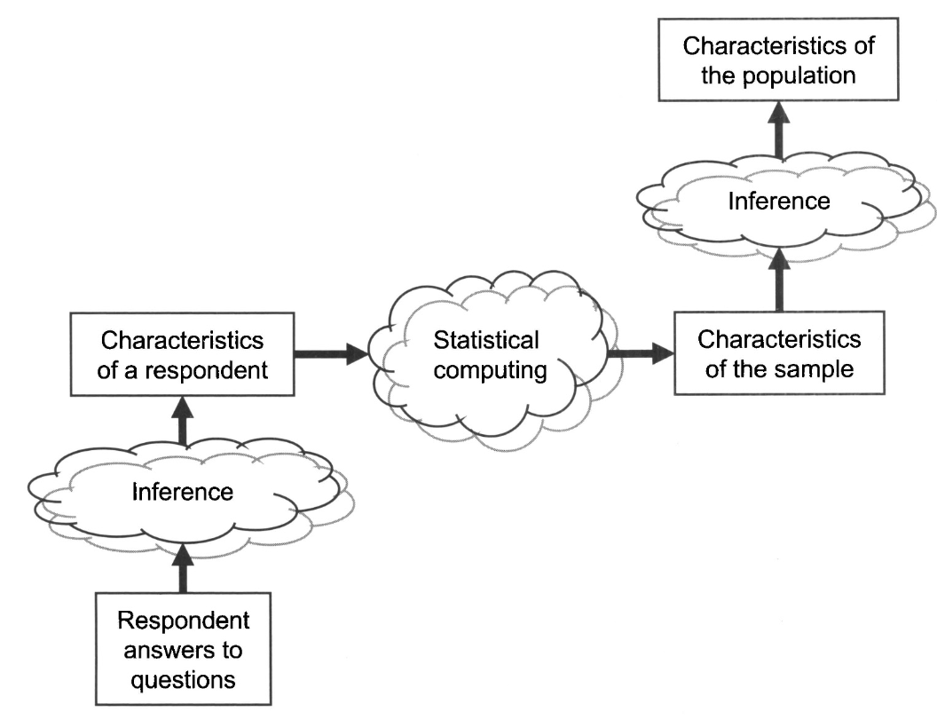
Inferences in Survey
Notes:
Surveys, however, are never interested in the characteristics of individual respondents per se. They are interested in statistics that combine those answers to summarize the characteristics ofgroups ofpersons.

Slide 3
Inferences in Survey
Answers people give must accurately describe characteristics of the respondents.
The subset of persons participating in the survey must have characteristics similar to those of a larger population.
When either of these two conditions is not met, the survey statistics are subject to "error."

Slide 4
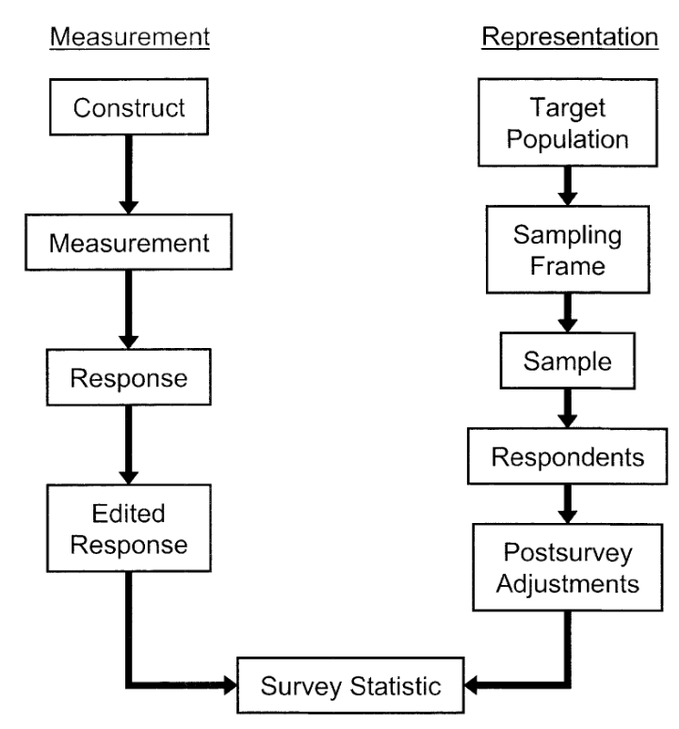
Survey lifecycle from a design perspective

Slide 5
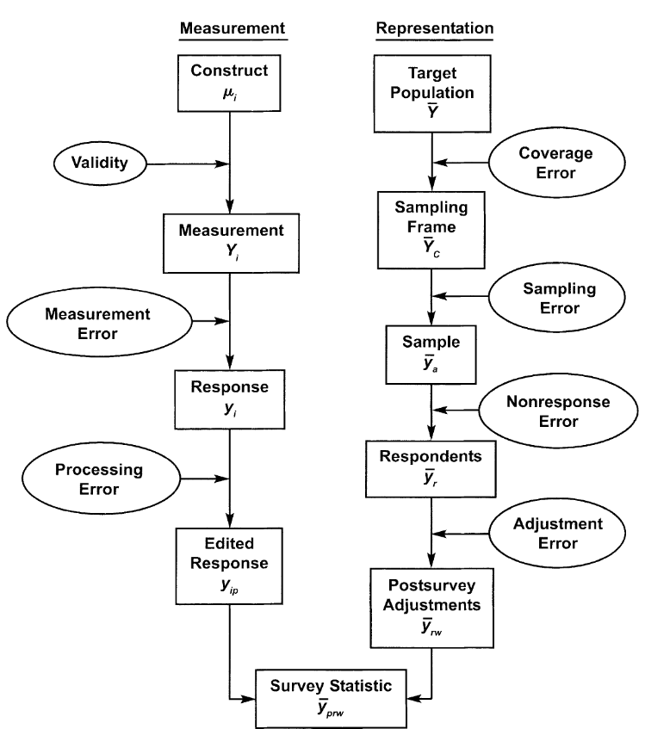

Survey lifecycle from a quality perspective
Survey error occurs when the estimate that is produced using survey data is different from the true value of the variable in the population one hopes to describe
Specification

Slide 6
Total survey error (TSE) is the difference between a population mean, total, or other population parameter and the estimate of the parameter based on the sample survey (or census).
TSE is the accumulation of all errors that may arise in the design, collection, processing, and analysis of survey data
TSE concept was developed by Robert Groves (1989) in book on Survey Errors and Survey Costs

Slide 7
The Total Survey Error Framework
There are several main types of error that surveyors must attempt to minimize
No source of error can be ignored

Slide 8
The Total Survey Error Framework
Surveyors often make the mistake of attempting to reduce one particular source of error while ignoring others
Instead, surveyors should think in terms of minimizing total survey error (TSE)
This involves attempting to maximize data accuracy by simultaneously controlling all four sources of error to the extent practical and possible, within the time, cost, and other constraints of the survey

Slide 9
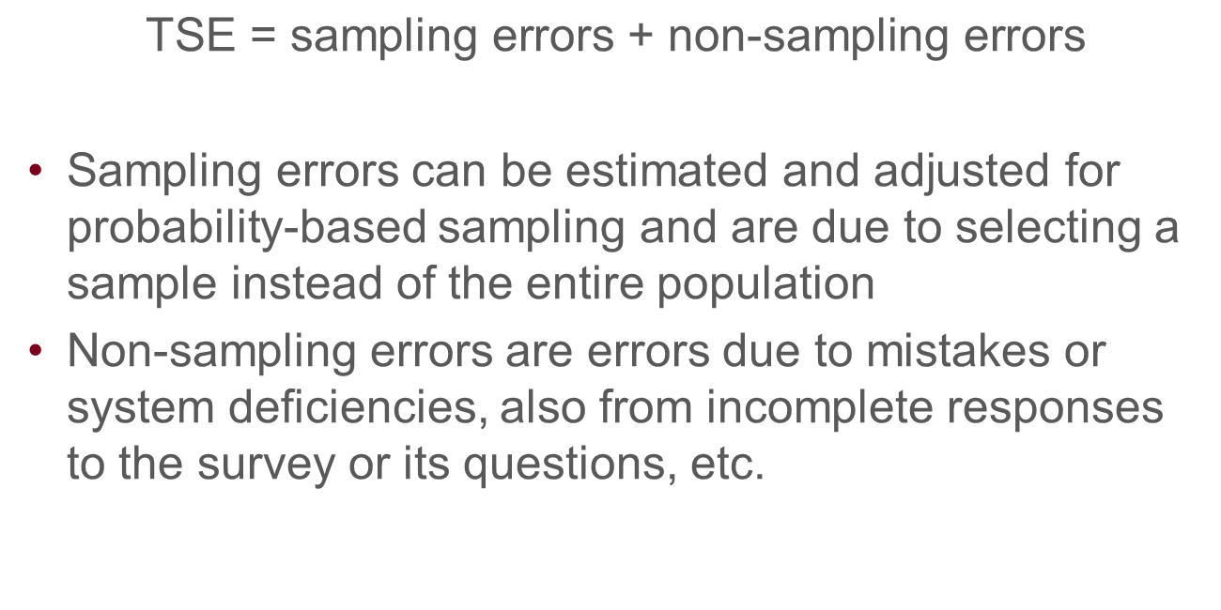
$$\text{TSE}\text{ = }\text{sampling} \text{errors}\text{ + }\text{non}\text{−}\text{sampling} \text{errors}$$
Sampling errors can be estimated and adjusted for probability-based sampling and are due to selecting a sample instead of the entire population
Non-sampling errors are errors due to mistakes or system deficiencies, also from incomplete responses to the survey or its questions, etc.

Slide 10
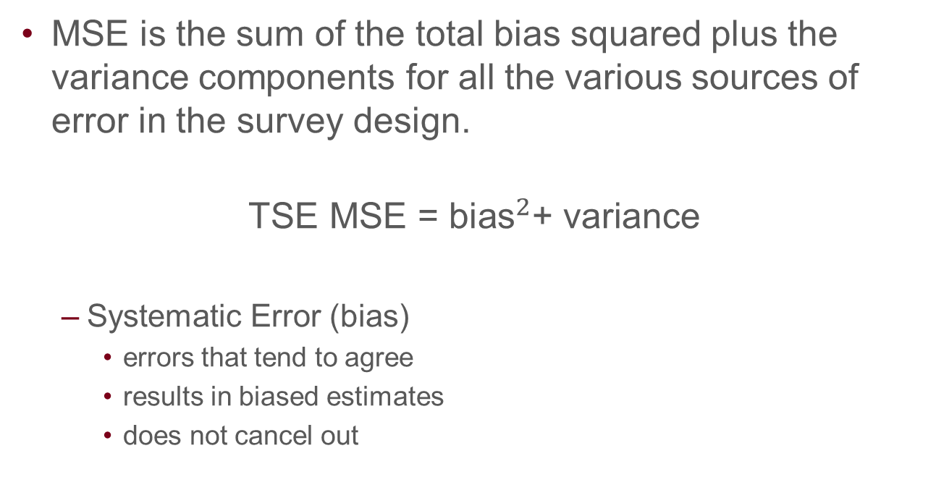
Mean Squared Error (MSE)
MSE is the sum of the total bias squared plus the variance components for all the various sources of error in the survey design.
$$\text{TSE} \text{MSE}\text{ = }{\text{bias}}^{2}\text{+ }\text{variance}$$
Systematic Error (bias)
errors that tend to agree
results in biased estimates
does not cancel out

Slide 11
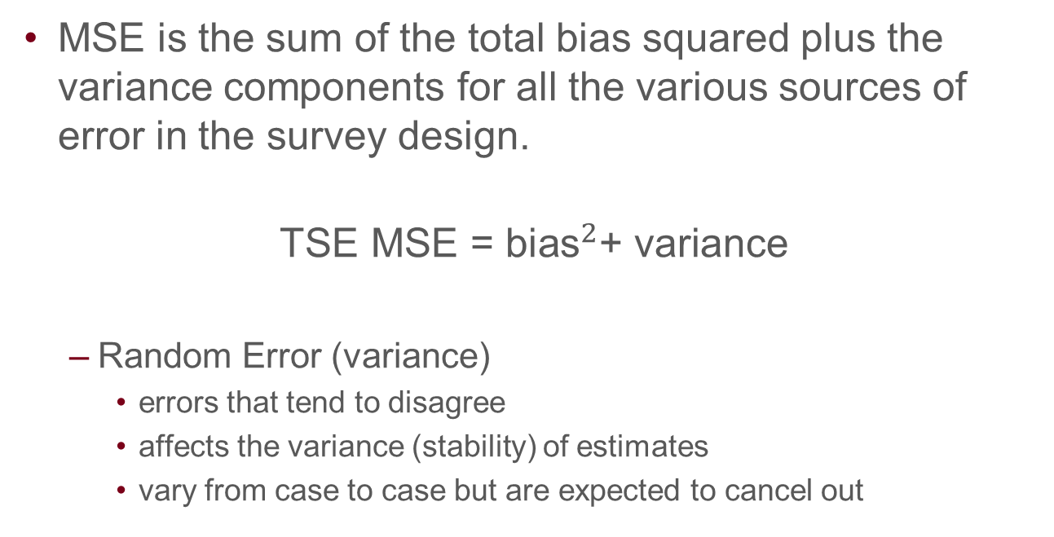
Mean Squared Error (MSE)
MSE is the sum of the total bias squared plus the variance components for all the various sources of error in the survey design.
$$\text{TSE} \text{MSE}\text{ = }{\text{bias}}^{2}\text{+ }\text{variance}$$
Random Error (variance)
errors that tend to disagree
affects the variance (stability) of estimates
vary from case to case but are expected to cancel out

Slide 12
Mean Squared Error (MSE)
MSE is a metric for measuring TSE
MSE cannot be calculated directly but useful conceptually to consider how large the different components can be and how much they add to the total survey error
Hypothetical but great guide for optimal survey designs
Survey design goal is to minimize the MSE
When other designs are similar on other quality dimensions, the optimal design is the one achieving the smallest mean squared error

Slide 13
Coverage Error
Occurs when the list of members of the target population from which sample members are drawn (the sampling frame) does not accurately reflect the population on the characteristic(s) the survey is trying to estimate
Coverage error is the difference between the estimate produced when the list is inaccurate and what would have been produced with an accurate list
A high-quality sample survey requires that every member of the population has a known, nonzero probability of being sampled.
The ideal case is when there is a one-to-one correspondence between the frame and target population units (i.e., each target unit is included once and only once on the frame, and the frame does not contain units that are not in the target population)

Slide 14
Undercoverage
If some units in the population are not on the list of the frame, there will be undercoverage
Those not on the list will have zero probability of being selected
When under-coverage occurs, the survey researcher faces three options:
Revise the sampling frame or use multiple frames,
Redefine the target population to fit the frame better,
Admit the possibility of coverage error in statistics describing the original target population.
Notes:
One example of frame noncoverage occurs when the frame population is defined by all possible telephone numbers and the target population is defined as all households. In the United States, about 6% of the households do not have a telephone, so they are all missed when the survey is conducted solely by telephone.
Using a new target population is subject to the criticism that the population is not the one of interest to the user of the survey statistics.
Maintaining the full household target population means that the survey is subject to the criticism that there is coverage error in its statistics.

Slide 15
Overcoverage
Overcoverage occurs when
Some units in the frame are not members of the target population (i.e., they are ineligible or out of scope for the survey) or
Some units have higher chance of being selected due to duplicated IDs
If cannot be removed a priori, the ineligible units are usually identified during the data collection and deleted with no biasing effects on the survey data.
Some units that are out of scope for the survey are mistaken for eligible units, and consequently, the estimates based on the survey results may be biased

Slide 16
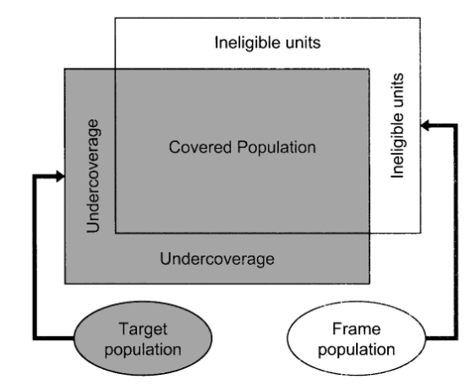
Coverage Error
Notes:
Lepkowski, J. M., Singer, E., Tourangeau, R., Groves, R. M., Fowler, F. J., & Couper, M. (n.d.). Survey Methodology. P.55

Slide 17
Sampling Error
The difference between the estimate produced when only a sample of units is surveyed and the estimate produced when all units are surveyed
Occurs any time a survey includes only some, rather than all, members of the sampling frame; it is unavoidable in sample surveys
But it can be minimized, and probability sampling allows us to obtain estimates about the population within acceptable levels of precision by surveying only a small portion of the population

Slide 18
Sampling Error
There are two types of sampling error: sampling bias and sampling variance.
Sampling bias arises when some members of the sampling frame are given no chance (or reduced chance) of selection.
Sampling variance arises because, given the design for the sample, by chance many different sets of frame elements could be drawn

Slide 19
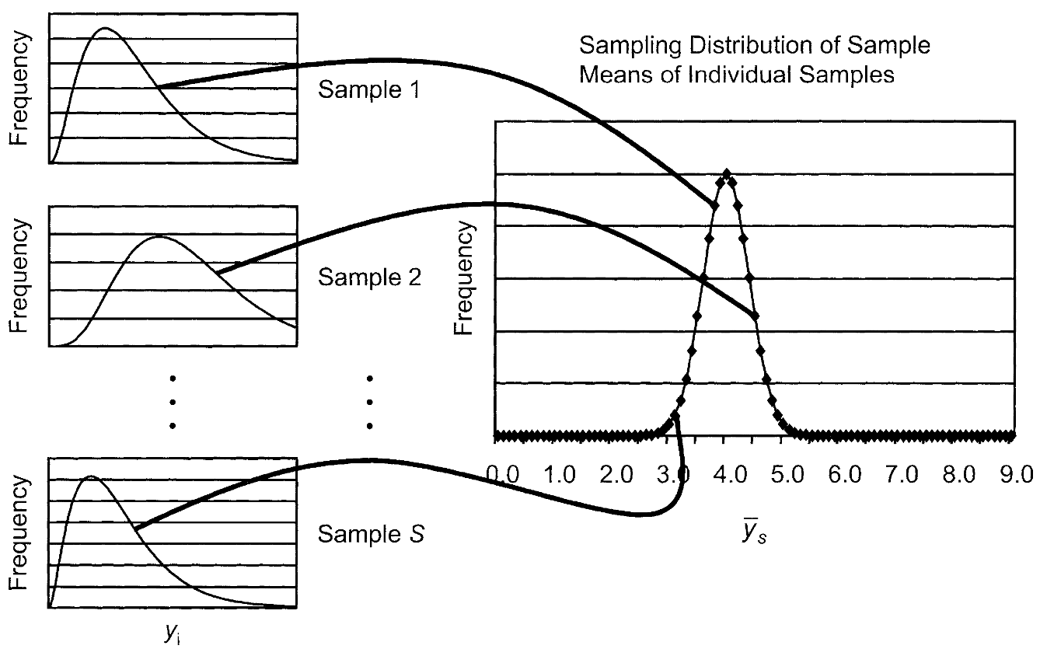
Sampling Error
Notes:
When sampling variance is high, the sample means are very unstable. In that situation, sampling error is very high. That means that for any given survey with that kind of design, there is a larger chance that the mean from the survey will be comparatively far from the true mean of the population from which the sample was drawn (the sample frame).

Slide 20
Sampling Error
The extent of the error due to sampling is a function of four basic principles of the design:
Whether all sampling frame elements have known, nonzero chances of selection into the sample (called "probability sampling")
Whether the sample is designed to control the representation of key subpopulations in the sample (called "stratification")
Whether individual elements are drawn directly and independently or in groups (called "element" or "cluster" samples)
How large a sample of elements is selected
Notes:
Sampling bias can be easily removed by giving all elements an equal chance of selection.

Slide 21
Sampling Error
Sampling bias can be easily removed by giving all elements an equal chance of selection.
Sampling variance is reduced with
big samples,
with samples that are stratified, and
samples that are not clustered.

Slide 22
Nonresponse Error
The difference between the estimate produced when only some of the sampled units respond to the survey compared to when all of them respond
It occurs if those who don’t respond are different from those who do in a way that influences the estimate
A high response rate can reduce the likelihood of nonresponse error, but it does not necessarily mean that there is low nonresponse error

Slide 23
Nonresponse Error
Unit nonresponse occurs when a sample unit does not response to any part of the survey
Item nonresponse occurs when the survey is only partially completed, and some items are not answered
Incomplete response occurs when the response to open-ended question is incomplete or very short and inadequate
Panel attrition occurs when a sample unit is lost over the period of a longitudinal study

Slide 24
Nonresponse Error
Nonresponse bias for the sample mean is the product of the nonresponse rate (the proportion of eligible sample elements for which data are not collected) and the difference between the respondent and nonrespondent mean.
This indicates that response rates alone are not quality indicators
High response rate surveys can have high nonresponse bias
High response rates reduce the risk of nonresponse bias
Notes:
High response rate surveys can also have high nonresponse bias (ifthe nonrespondents are very distinctive on the survey variable). The best way to think about this is that high response rates reduce the risk of nonresponse bias.

Slide 25
Measurement Error
The difference between the estimate produced and the true value because respondents gave inaccurate answers
X
T
E

Slide 26
Measurement Error
Respondents may be unwilling or unable to provide accurate answers for a variety of reasons: poor question design, survey mode effects, interviewer and respondent behavior, or data collection mistakes
even if the question is a good way to measure a specific concept, there are many other ways in which measurement error can still occur

Slide 27
Measurement Error
Random error
Systematic error
Random in nature
Occurs when source of error always increase or decrease a true score
Will increase and decrease a person’s score by exactly the same amount with infinite testing
Cancels itself out
Lowers reliability of a test
Does not lower reliability of a test since the test is reliably inaccurate by the same amount each time

Slide 28
Measurement Error
Standard error of measurement (SEM) is defined as the standard deviation of an individual’s observed scores around their true score
SEM is an index of the amount of inconsistency or error expected in an individual’s observed test score
SEM is an estimate of how much the individual’s observed test score might differ from the individual’s true test score
SEM can be used to quantify the amount of random measurement error

Slide 29
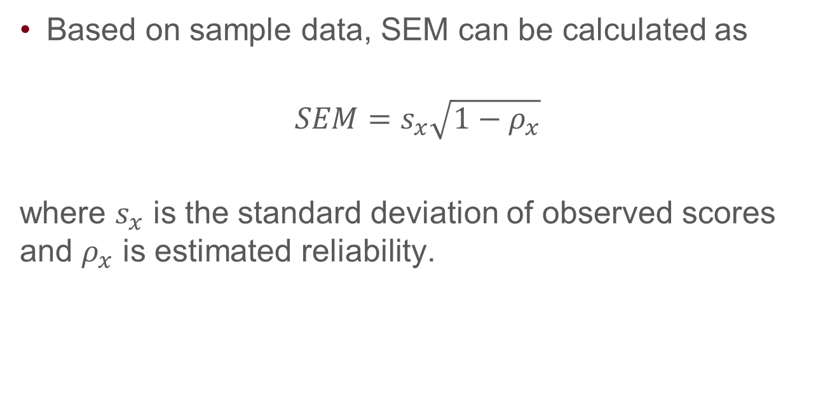
Measurement Error
Based on sample data, SEM can be calculated as
$$SEM=s_{x}\sqrt{1−ρ_{x}}$$
where $s_{x}$ is the standard deviation of observed scores and $ρ_{x}$ is estimated reliability.

Slide 30
Measurement Error
As an example, if the standard deviation for a sample of observed assessment scores was 15, and the reliability of the scale, as estimated using the coefficient alpha method was 0.75, then the SEM would be calculated as ________
After obtaining the SEM, a 95% confidence interval can be constructed for observed score x +/- 1.96SEM
The 95% confidence interval for an observed score of 87 is [________,_______]

Slide 31
Specification Error
Specification error may occur when there is a mismatch between what the survey is measuring and what it is intended to measure
When psychological tests are used, this is about the validity of the test scores

Slide 32
Specification Error
Bureau of Labor Statistics (BLS) defines people “on layoff” as those who are separated from a job and await a recall to return to that job.
‘‘Were you on layoff from a job?’’ (a previous version before 1994)
To many people, the term ‘‘layoff’’ could mean permanent termination
‘‘Has your employer given you a date to return to work?’’ and ‘‘Could you have returned to work if you had been recalled?’’ (new questions after 1994)
Notes:
An example of specification error is in the measurement of unemployment in the Current Population Survey (CPS) (U.S. Department of Labor, Bureau of Labor Statistics, and U.S. Department of Commerce, Bureau of the Census 2002). For the Bureau of Labor Statistics (BLS), an important distinction among unemployed persons is whether they were ‘‘looking for work’’ or ‘‘on layoff.’’ Persons on layoff are defined as those who are separated from a job and await a recall to return to that job. Persons who are ‘‘looking for work’’ are the unemployed who are not on layoff and who are pursuing certain specified activities to find employment. Prior to 1994, the CPS questionnaire did not consider or collect information on the expectation of recall from persons who indicated that they had been laid off. Rather, unemployed persons were simply asked, ‘‘Were you on layoff from a job?’’ This question was problematic because, to many people, the term ‘‘layoff’’ could mean permanent termination from the job rather than the temporary loss of work the BLS economists were trying to measure. (See Biemer 2004 for an extensive discussion and analysis of this problem.) BLS redesigned this question in 1994 to clarify the concept of layoff. Currently, unemployed persons are asked, ‘‘Has your employer given you a date to return to work?’’ and ‘‘Could you have returned to work if you had been recalled?’’ These questions brought the concept of ‘‘on layoff’’ in line with the specification being used by BLS economists and produced slightly different estimates of unemployment

Slide 33
Processing Errors
errors that arise during the data processing stage, including errors in the editing of data, data entry, coding, the assignment of survey weights, and the tabulation of survey data.
For open-ended items that are coded, coding error is another type of data processing error.

